Slide 1
July 2021 OGC API Virtual Code Sprint
July 21, 2021
#OGCAPI

Slide 2
Housekeeping
Only switch your microphone on when speaking.
Follow the chair/facilitator’s instructions.
Say your name before speaking...
“Hi, this is Gobe…”

Slide 5
Welcome
What is an OGC Code Sprint?
A collaborative and inclusive event driven by innovative and rapid programming with minimum process and organization constraints to support the development of new applications and open standards.
The scope of the code sprint is to include:
API implementation
API testing and feedback
Discussion and knowledge sharing
Objectives of the code sprint
Develop prototype implementations of OGC API – Processes
Develop prototype implementations of OGC API – Records
Develop prototype implementations of OGC API – Coverages
Test the prototype implementations
Provide feedback to the Editor about what worked and what did not work
Provide feedback about the specification document, especially what is missing from the document

Slide 6
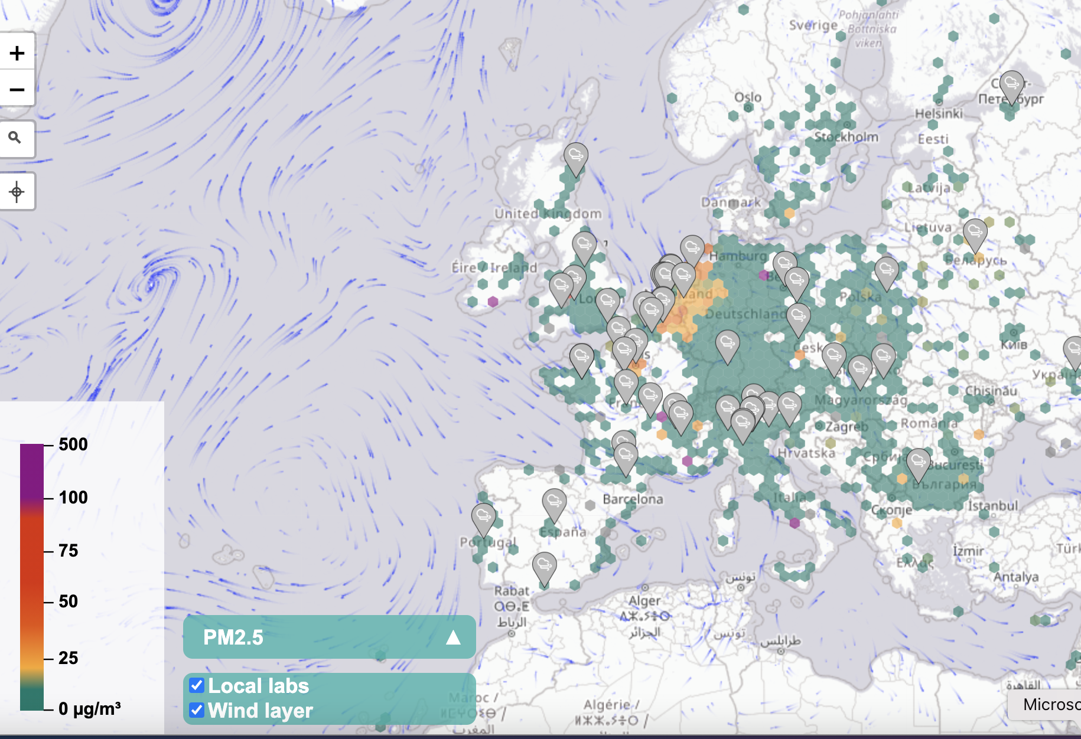
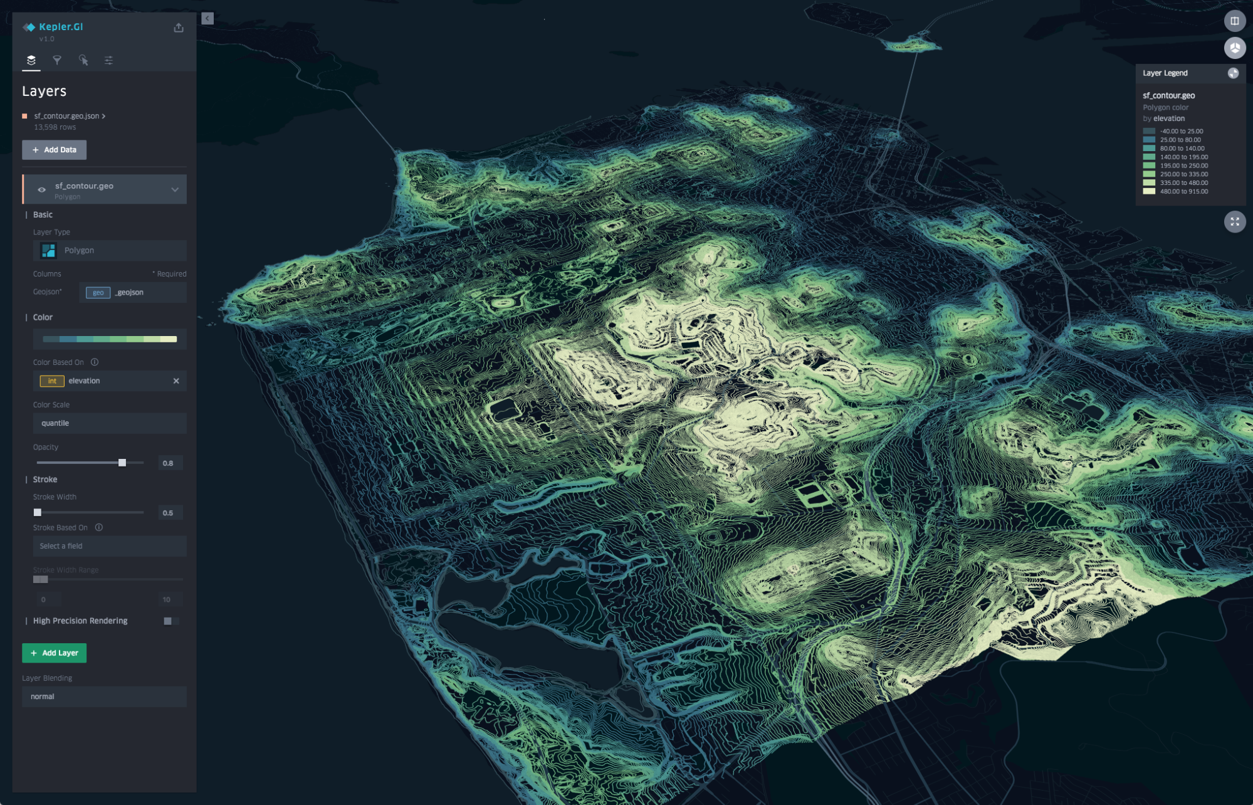
Motivation
The growing uptake of location within and beyond geospatial developer communities

Slide 7



Motivation
APIs are a popular, effective method for rapid software development

Slide 8
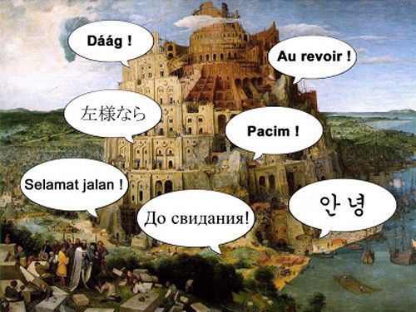
Motivation
There is an increasing need for interoperability between Web APIs

Slide 9


Participants
Who is joining this Sprint?
I have several years of professional software development experience and write code almost every day.
Coding is not my day to day job, but I often hack on things to solve key problems.

Slide 10
Sprint Goals
OGC API – Processes

Slide 11
Overview of the draft specification
OGC API - Processes - Part 3: Workflows

Slide 12
Sprint Goals
OGC API – Records

Slide 13
Sprint Goals
OGC API – Coverages

Slide 14
Sprint Description
The scope of the code sprint is to include:
API implementation
API testing and feedback
Discussion and knowledge sharing
.

Slide 15
Ways of Working
Participants are welcome to bring partial or complete implementations of servers or clients to support the sprint.
Participants will have the opportunity to experiment with parts of the specification and develop working services.
This development can either be done with:
source data that participants bring to the event themselves, or
source data made available by other organizations.

Slide 16
Sprint Cycle
Discuss in Telecon
Implement
Discuss on Gitter
Demonstrate

Slide 17
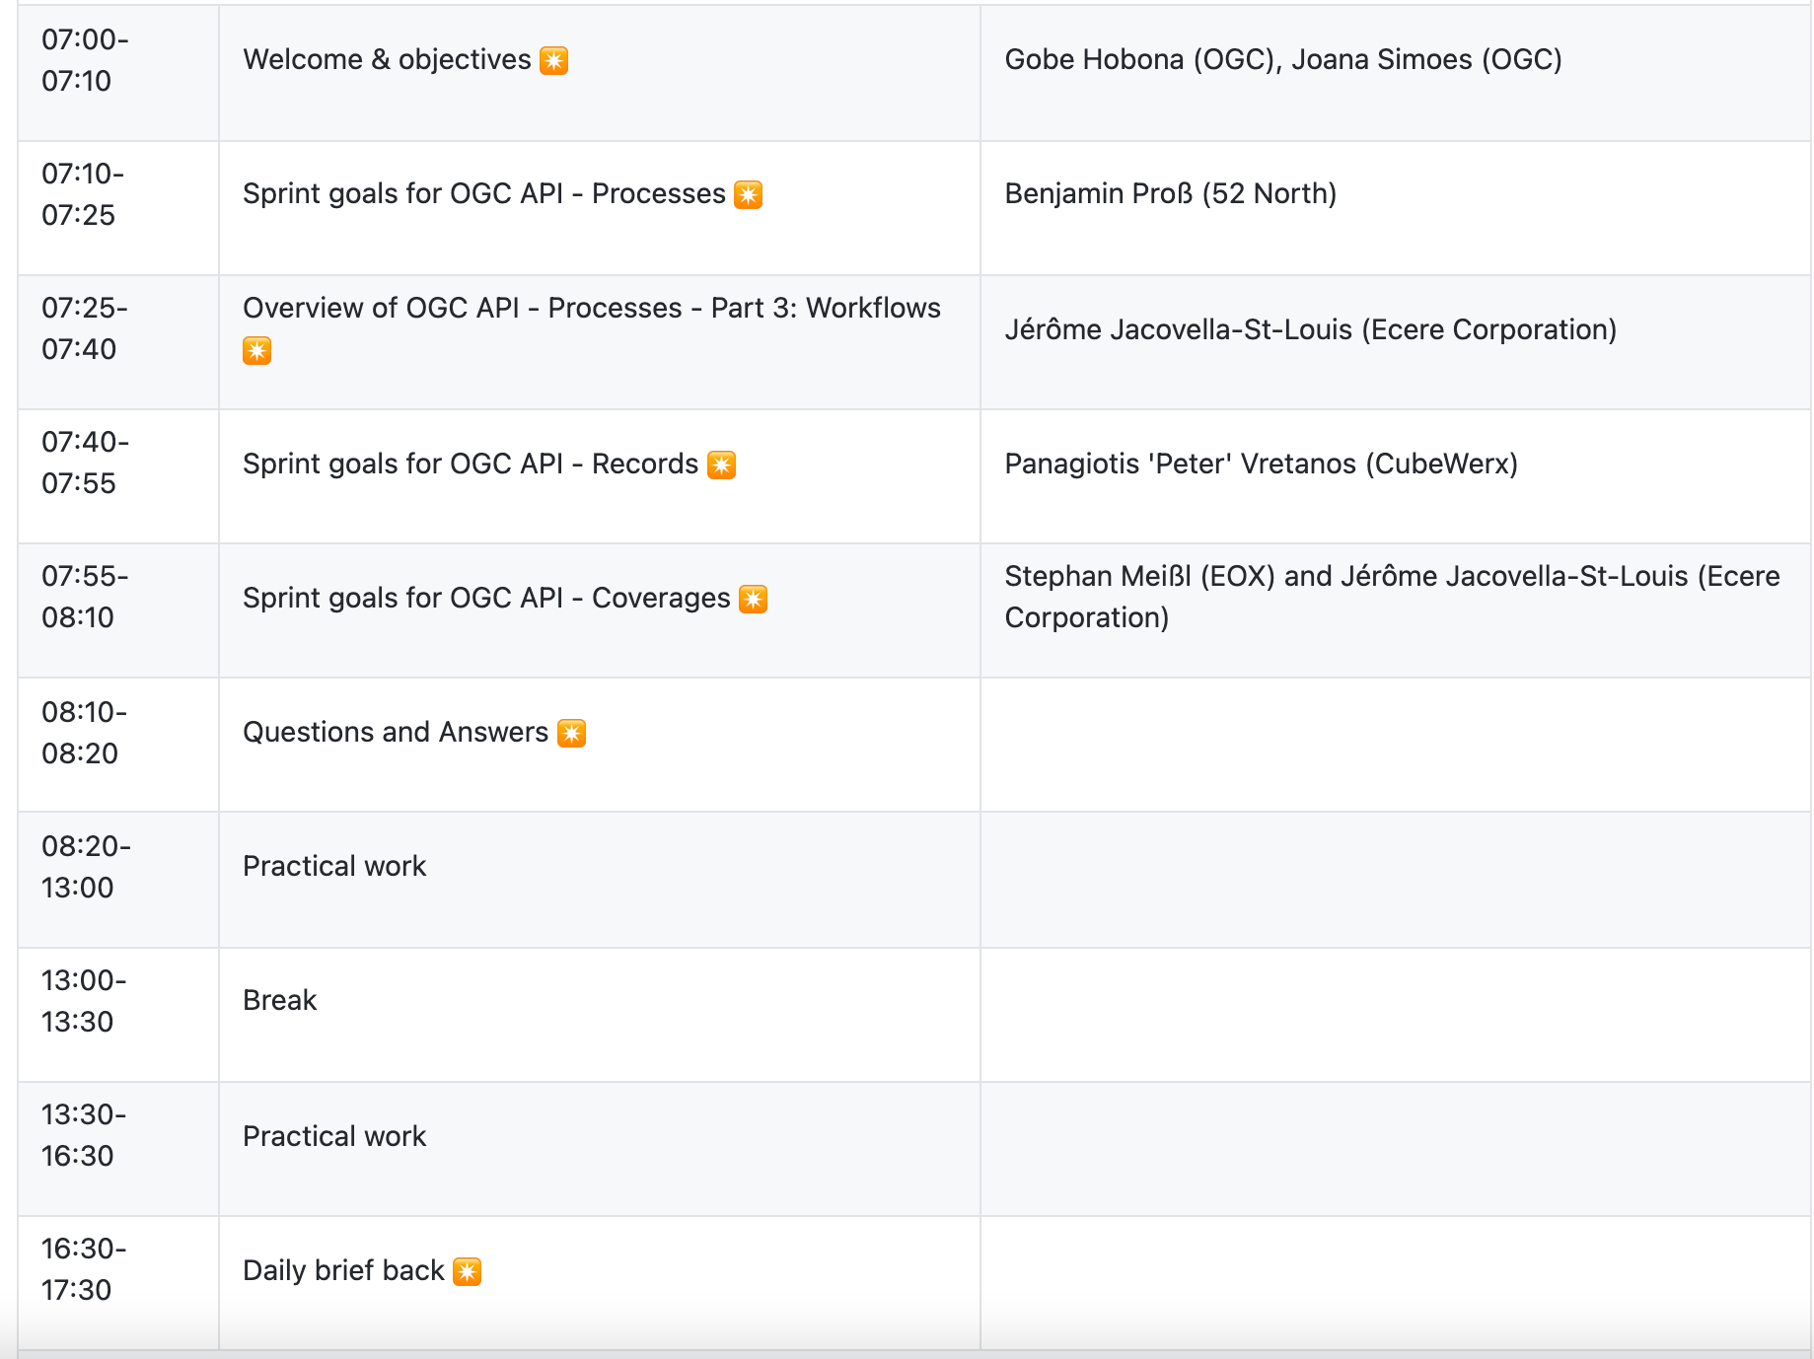
Sprint Schedule – Day 1 – July 21
Notes:
All times are in EDT

Slide 18
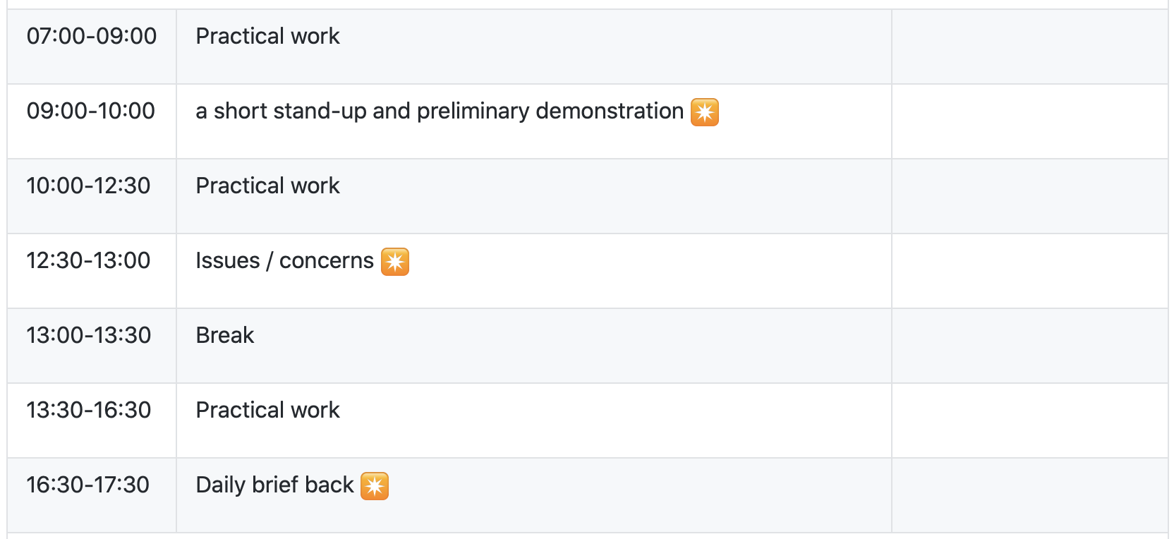
Sprint Schedule – Day 2 – July 22

Slide 19
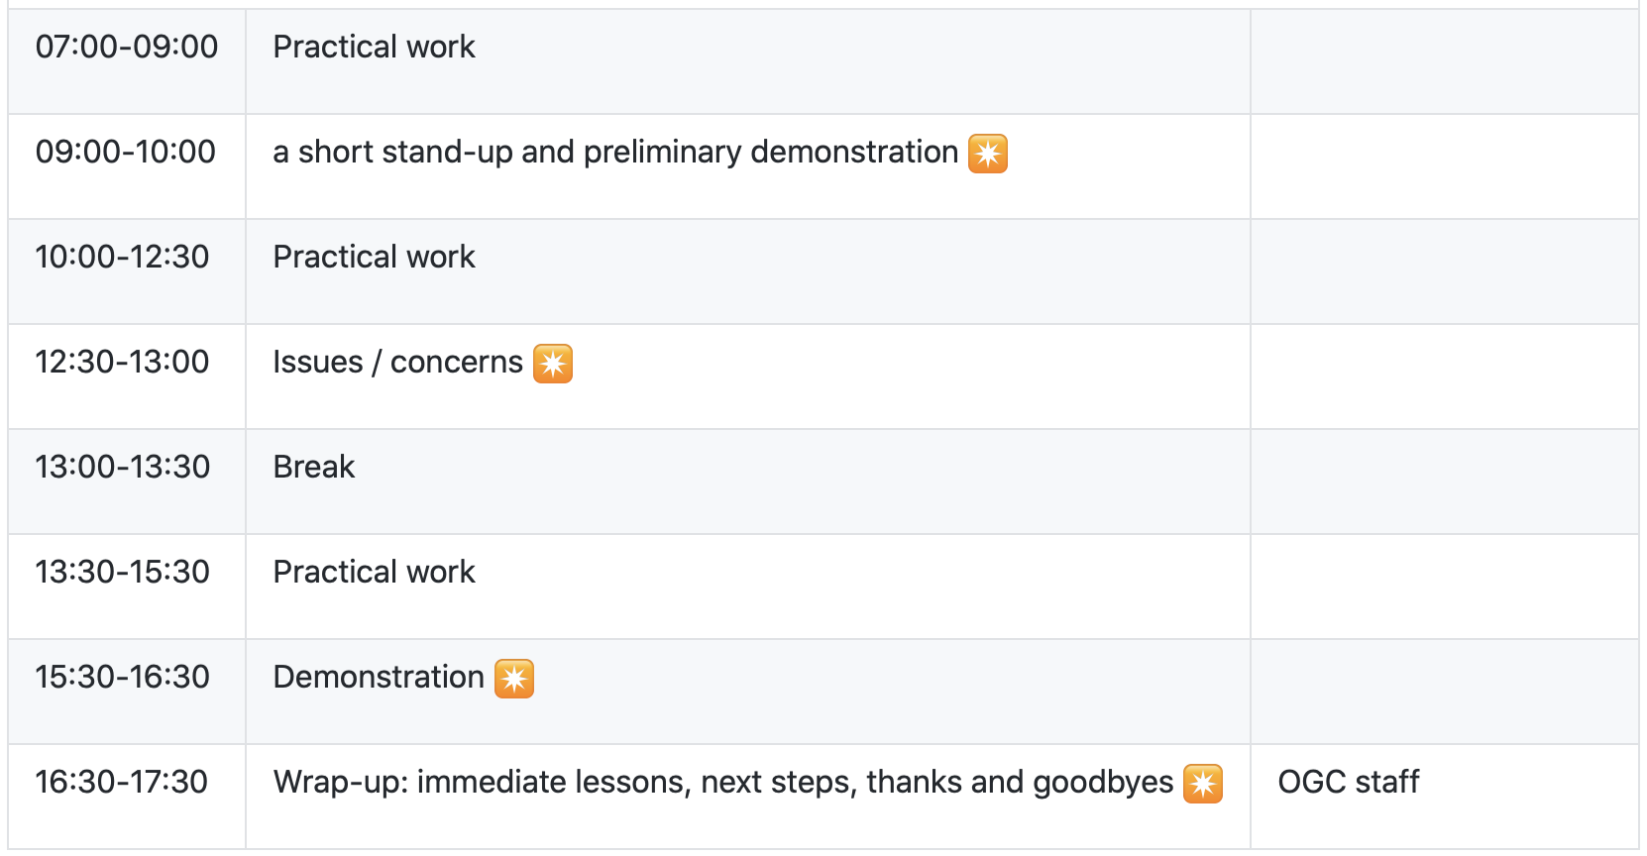
Sprint Schedule – Day 3 – July 23

Slide 20
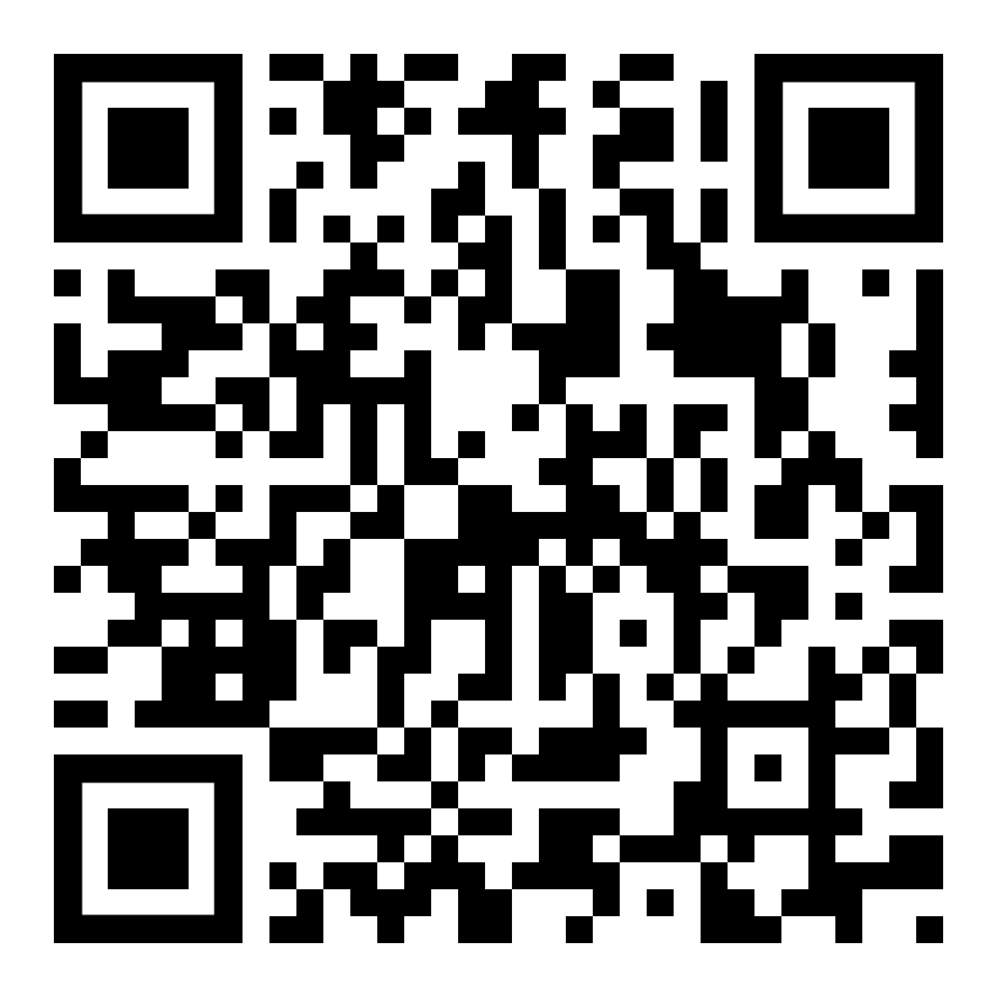
Logistics
Gotomeeting
Link to be provided to registered participants only.
Gitter
https://gitter.im/ogc-developer/Sprints
GitHub
Sprint repo https://github.com/opengeospatial/ogcapi-code-sprint-2021-07

Slide 21
Community
500+ International Members
110+ Member Meetings
60+ Alliance and Liaison partners
50+ Standards Working Groups
45+ Domain Working Groups
25+ Years of Not for Profit Work 10+ Regional and Country Forums
Innovation
120+ Innovation Initiatives
380+ Technical reports
Quarterly Tech Trends monitoring
Standards
65+ Adopted Standards
300+ products with 1000+ certified implementations
1,700,000+ Operational Data Sets Using OGC Standards
Contact info@ogc.org to schedule a meeting for an in-depth discussion with OGC staff and join our community today!
Notes:
If you have any questions, do not hesitate to reach out to OGC or schedule a follow-up. We’re working constantly to change the landscape of location information and want to help your organization get where it needs to go.

